Slide 1



ADNEX model systematic review and meta-analysis
Lasai Barreñada
Ledger, Dhiman, Collins, Wynants, Valentin,
Verbakel, Timmerman and Van Calster
Department of Development and Regeneration, KU Leuven
Notes:
Good Morning everyone,
My name is Lasai Barreñada and today I will be presenting a systematic review and meta-analysis of external validation studies of IOTA ADNEX model

Slide 2
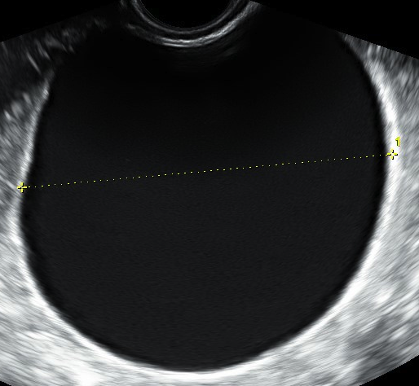
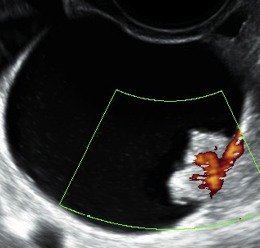
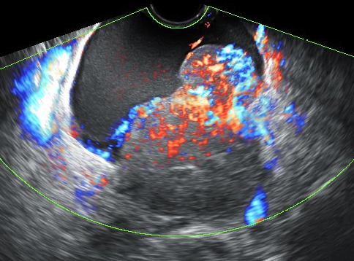
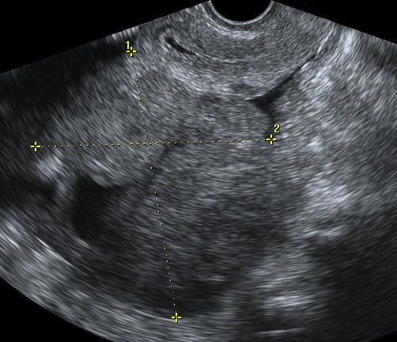
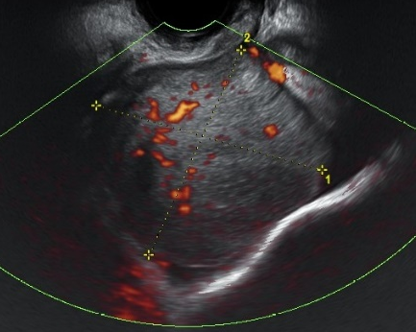
ADNEX model
Logistic regression model that estimates the risk of 5 tumor types
Malignant
+
Stage II-IV
invasive
Secondary
metastatic
Benign
Borderline
+
Stage I invasive
+
Notes:
ADNEX is a logistic regression model that estimates the risk of 5 tumour types. The formula has 2 version one without CA125 and with CA125. Benign, Borderline, Stage I or stage II-IV invasive and secondary metastatic. Adding the last four tumour types the model gives the risk of malignancy of the tumour.

Slide 3
Inclusion: All papers validating original ADNEX
Notes:
In our systematic review we wanted to included all papers that validated ADNEX in any way, in any population and any country.
In the figure you can see the geographical distribution of the included studies in the SR and the number of patients in those studies. We are happy to see that ADNEX is used across the world and I would like to highlight the spread in Asia with China and South Korea for example having 13 studies and more than 4000 patients.

Slide 4
Results
General AUC = 0.93
 | Studies | 47
 | Tumours | 17007
 | Countries | 28
 | Median sample size | 261
Study characteristic |  | N
Unit of analysis | Patient | 42
 | Tumour | 5
Number of centers | 1 | 37
 | >1 | 10
Type of centre | Oncology centre | 35
 | Non-oncology | 2
 | Both | 4
 | Unclear | 6
ADNEX version | With CA125 | 37
 | Without CA125 | 19
Selection based on histology | No | 39
 | Yes | 8
Risk of bias | High or unclear | 45
 | Low | 2
Notes:
V3
After the selection process we included 47 studies in the review. This accounted for 17007 tumours in 28 different countries. The median sample size was of 261 tumour. Regarding the characteristics of the studies most of them used patient as unity of analysis, where conducted on a single center. The type of centre was normally oncology centre. The ADNEX version validated was mostly the version with CA125. Some studies selected the patients based on histological results, for example including only borderline tumours so these where excluded from the meta-analysis. Finally, regarding risk of bias we identified 45 studies at high or unclear risk of bias and only 2 papers at low risk of bias.
In the forest plot you can see the different meta-analysis results. The general AUC both for ADNEX with and without CA125 was 0.93 and remained stable in different subgroups based on risk of bias, IOTA link, geographical location, type of centre or menopausal status. We also meta-analysed the performance in cohorts that included patients conservatively managed with also good results.

Slide 5

Conclusions
The ADNEX model exhibits robust discrimination between benign and malignant tumours across various settings and populations.
Results support the use of ADNEX for:
Choosing between surgery or conservative management
Decisions on surgery (how, where and by whom)
More info
Room for improvement in methodology reporting and risk of bias
Avoid complete case analysis
Rationale for sample size
Report calibration
TRIPOD
Notes:
The conclusion of the review is that ADNEX exhibits robust discrimination between benign and malignant tumours across various settings and populations with an AUC higher than 0.9 in all performed meta-analysis.
This systematic review supports the use of ADNEX for 2 situations. First ADNEX without CA125 can determine the likelihood of the mass being benign or malignant so support wether the patients gets operated or is followed conservatively. However, if the mass looks malignant, ADNEX with CA125 can help to determine the malignant subtype and hence help decision about surgery.
However we identified important flaws in study reporting and methodology. The most common problems that we identified are the exclusion of patients with missing values, the inexistent explanation for sample sizes and not reporting the calibration of the model. To improve this I would recommend all clinicians that are working in external validation of ADNEX and similar prediction models to adhere to international reporting guidelines such as TRIPOD or STARD.
Possible questions:
- Have you checked for publication bias or small study effects? Yes we used funnel plots of AUC for that and we did not identify a clear publication bias.
- Sensitivity and specificity? We also performed meta-analysis of sensitivity and specificity at the cutoff value of 10% risk of malignancy with a pooled result of 0.93 sensitivity and 0.75 specificity .
- Number of studies in meta-analysis? There were 36 eligible studies for the meta-analysis but depending on the version of meta-analysis this varied. The main study with CA125 included 21 studies and without 12. But for example the validation by Van Calster et al (2020) has 14 validations.
- What was the prevalence in the meta-analysis? 28% in the included studies in the meta-analysis but this differed depending on the analysis.
- CA125 was mainly useful to differentiate between malignant subtypes. Specifically for differentiationg between advanced stage cancers and metastatic cancers.

